Slide 1


NanoSat MO Framework: Software Development Kit (NMF: SDK)
Presentation prepared by César Coelho

Slide 2
NanoSat MO Framework (NMF)
Why “NanoSat MO Framework”?
Because it is a software framework for nanosatellites based on
CCSDS Mission Operations (MO) services.
Characteristics and new Concepts
Brings “Apps” into space
Simple Software Management: install/start/stop
Monitoring and control capabilities for apps
Platform-independent
Open-source

Slide 3


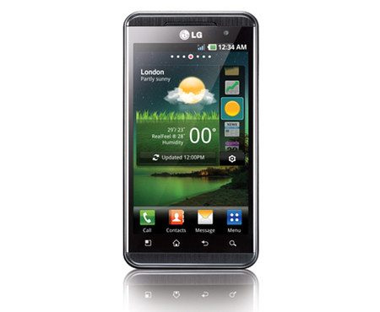
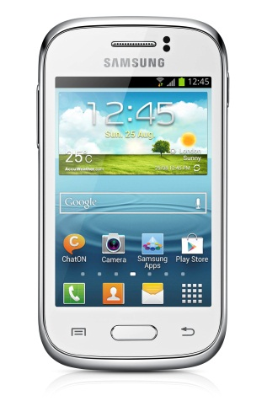

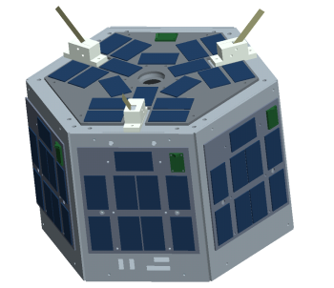
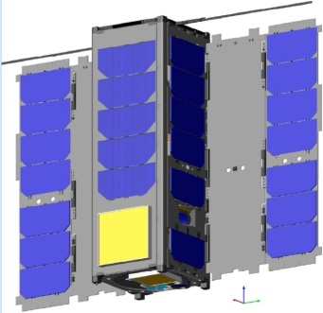
Apps in space, the smartphone’s analogy
NanoSat MO Framework

Slide 4
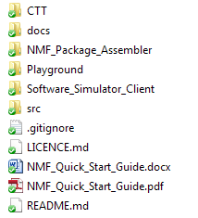
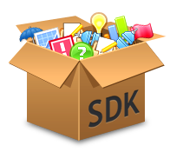
Software Development Kit (SDK)
The NMF SDK includes:
Consumer Test Tool (CTT)
Documentation
NMF Package Assembler
Playground environment
Software Simulator Client
Source code examples
“Quick Start Guide”
The starting point of the NMF SDK is the “Quick Start Guide”.

Slide 5
Playground environment
The Playground environment includes 2 folders:
“apps” for applications
NanoSat MO Supervisor
Demos of NMF Apps
Benchmark App
“libs” for libraries
NanoSat MO Framework

Slide 6
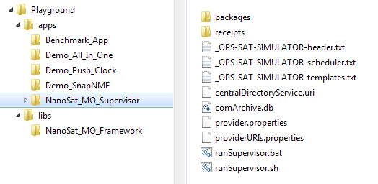
Playground environment
To start the NanoSat MO Supervisor, launch:
bin/space-nanosat-mo-supervisor/space-nanosat-mo-supervisor
NMF Apps can be started through the Apps Launcher service.

Slide 7
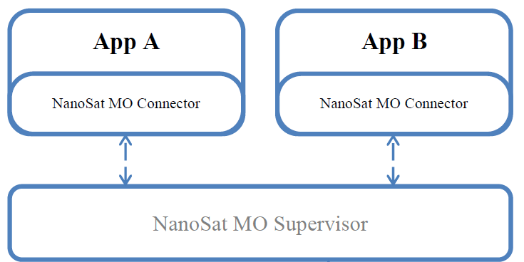
NanoSat MO Supervisor
In the NMF world, the NanoSat MO Supervisor is responsible for:
Start/Stop/Kill
Install/Uninstall/Update
Tracking all running NMF Apps on the Central Directory service

Slide 8
OPS-SAT Software Simulator
The NanoSat MO Supervisor of the Playground environment includes an integrated OPS-SAT Software Simulator.
This allows the retrieval of similar data to OPS-SAT’s platform peripherals
OPS-SAT Software Simulator

Slide 9
OPS-SAT Software Simulator
OPS-SAT Software Simulator:
Lightweight
Includes a scheduler to create scenarios
Very Simple
The main advantage of this simulator is its simplicity and easiness of use, not the quality of the data.

Slide 10
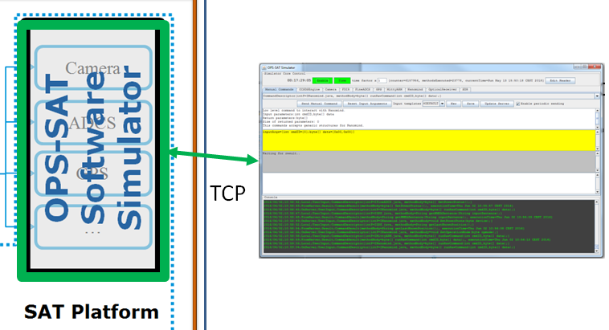
OPS-SAT Software Simulator client
There is a client application to control the Software Simulator:
bin/spacecraft-simulator-gui/spacecraft-simulator-gui

Slide 11
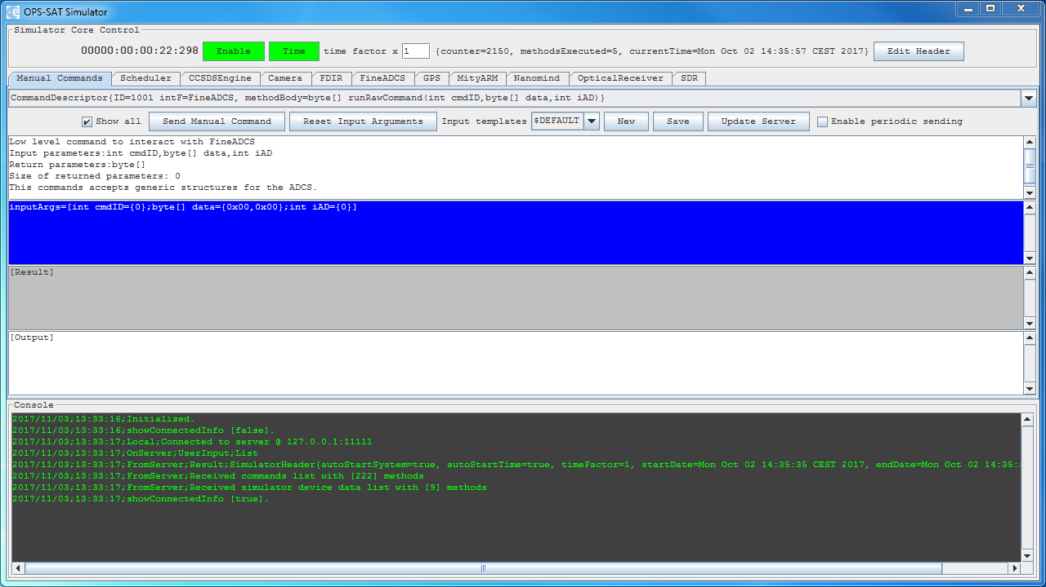
OPS-SAT Software Simulator client

Slide 12
Consumer Test Tool (CTT)
The Consumer Test Tool (CTT) is an application to aid developers in the process of testing newly developed NMF Apps from a user-friendly interface. It includes a set of GUI panels that provides a Graphical User Interface (GUI) to interact with the services on a provider.
To start the CTT, launch:
bin/consumer-test-tool/consumer-test-tool
Please notice:
CTT is not the OPS-SAT Software simulator client from the previous slides

Slide 13
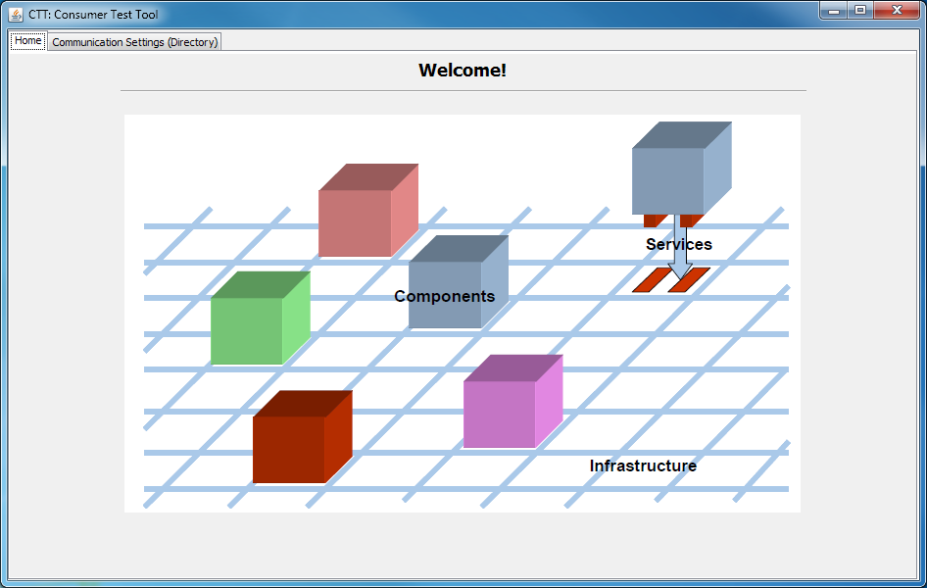
Consumer Test Tool (CTT)

Slide 14
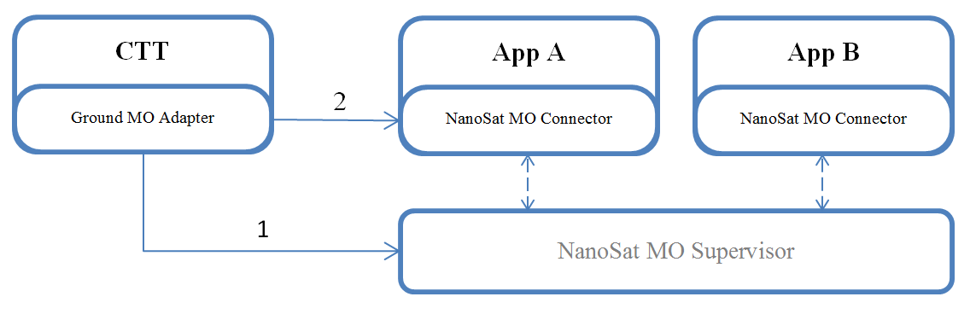
A quick demo: Setup

Slide 15
A quick demo: CTT

Slide 16
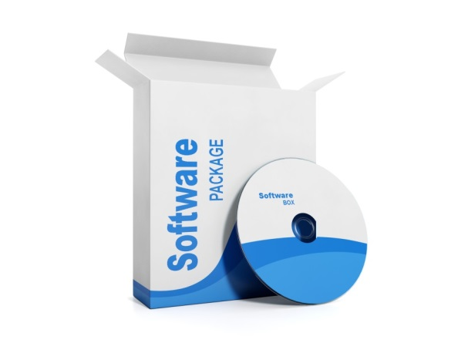
NMF Package concept
An NMF Package is a digital content distribution package intended to be used to install, uninstall and update applications on a spacecraft system that uses the NanoSat MO Framework.
How does it work?
Transfer the NMF Package to space
Install/Update/Uninstall the NMF Package
Start/Stop/Kill apps

Slide 17
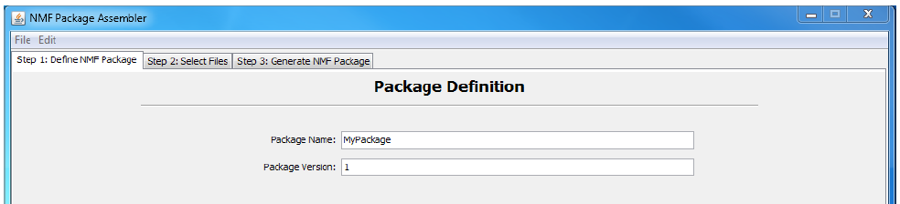
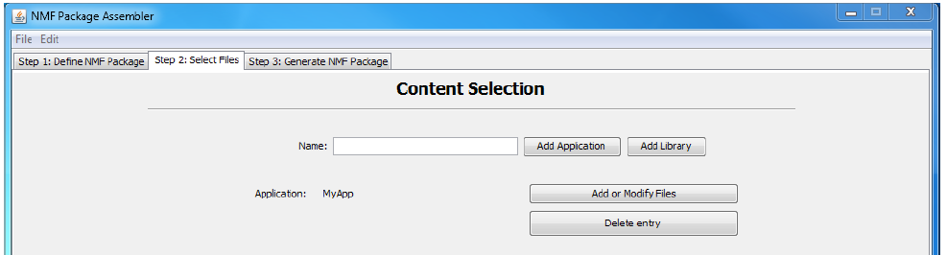
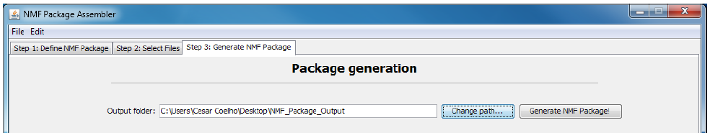
NMF Package Assembler
The NMF Package Assembler is an application that allows a user to assemble NMF Packages from a user-friendly GUI. The application includes three tabs: One for defining properties, another for selecting the files to be part of the package, and finally a tab for the generation of the NMF Package.

Slide 18
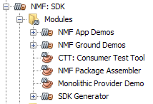
Source Code Examples
The NMF SDK’s source code examples are available in the “src” folder of the NMF SDK. This includes demos of NMF Apps, demos of NMF Ground applications, a demo of a Monolithic Provider, and some other projects.

Slide 19
Documentation
The “Quick Start Guide” is the entry point for anyone using the NMF SDK for the first time. The guide provides a high-level view of the NanoSat MO Framework, the new concepts, and a quick “test drive” by running an NMF App and connecting to it.
The “docs” folder contains:
Guide to develop NMF Apps
Guide to develop NMF Ground applications
NMF Javadocs
Generated documents for all MO services (in NMF)
ECSS documentation

Slide 20
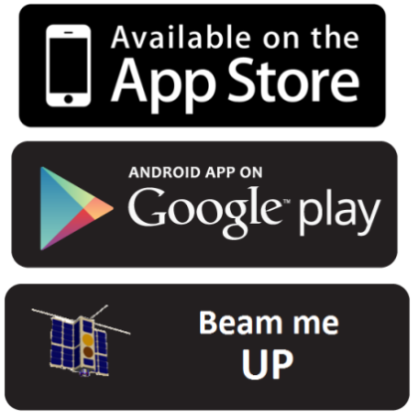
Thank you
NanoSat MO Framework
A software framework for nanosatellites
Download it for free:
https://nanosat-mo-framework.github.io/

